Slide 1

18CSC303J – Database Management Systems
Unit III – SQL & PL/SQL

Slide 2
Course Learning Outcome (CLO)
Apply the knowledge to create, store and retrieve data using Structure Query Language (SQL) and PL/SQL

Slide 3
Topics Covered
Basics of SQL- DDL,DML,TCL
Structure Creation
Constraints
Functions-Built-in , Aggregate
Subqueries
Set operations
Triggers
Query processing
Transaction control commands
Views
PL/SQL

Slide 4
Basics of SQL-DDL,DML,DCL,TCL

Slide 5
SQL
Structured Query Language(SQL) as we all know is the database language by the use of which we can perform certain operations on the existing database and also we can use this language to create a database. SQL uses certain commands like Create, Drop, Insert etc. to carry out the required tasks.
These SQL commands are mainly categorized into four categories as:
DDL – Data Definition Language
DML – Data Manipulation Language
DCL – Data Control Language
TCL – Transaction Control Language

Slide 6
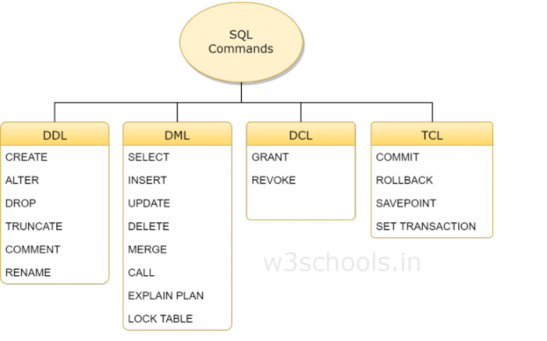

Slide 7
DDL Introduction
DDL is short name of Data Definition Language, which deals with database schemas and descriptions, of how the data should reside in the database.
CREATE - to create a database and its objects like (table, index, views, store procedure, function, and triggers)
ALTER - alters the structure of the existing database
DROP - delete objects from the database
TRUNCATE - remove all records from a table, including all spaces allocated for the records are removed
COMMENT - add comments to the data dictionary
RENAME - rename an object

Slide 8
DML Introduction
DML is short name of Data Manipulation Language which deals with data manipulation and includes most common SQL statements such SELECT, INSERT, UPDATE, DELETE, etc., and it is used to store, modify, retrieve, delete and update data in a database.
SELECT - retrieve data from a database
INSERT - insert data into a table
UPDATE - updates existing data within a table
DELETE - Delete all records from a database table

Slide 9
DCL Introduction
DCL is short name of Data Control Language which includes commands such as GRANT and mostly concerned with rights, permissions and other controls of the database system.
GRANT - allow users access privileges to the database
REVOKE - withdraw users access privileges given by using the GRANT command

Slide 10
TCL Introduction
TCL is short name of Transaction Control Language which deals with a transaction within a database.
COMMIT - commits a Transaction
ROLLBACK - rollback a transaction in case of any error occurs
SAVEPOINT - to rollback the transaction making points within groups
SET TRANSACTION - specify characteristics of the transaction

Slide 11
DDL-Structure creation Creating a Table
Syntax
CREATE TABLE table_name
(Column_name datatype[(size)],
Column_name datatype[(size)],
);
Example
CREATE TABLE stud
(Regno varchar2(10),
Name char(50),
DOB date,
Address varchar2(50));
Creates a table with four columns

Slide 12
Data Types
Following broad categories of data types exist in most databases:
String Data
Numeric Data
Temporal Data
Large Objects

Slide 13
String Data
Fixed Length:
Occupies the same length of space in memory no matter how much data is stored in them.
Syntax:
char(n) where n is the length of the String
e.g. name char(50)
If the variable stored for name is ‘Sanjay’ the extra 43 fields are padded with blanks

Slide 14
String Data
Variable Length string is specified with maximum length of characters possible in the string, however, the allocation is sized to the size of the data stored in memory.
Syntax:
Varchar(n) – n is the maximum length of data possible for the type
There may be a restriction in the maximum length of the data that you can specify in the declaration which will vary according to the database.
All character data has to be enclosed in single quotes during specification.

Slide 15
Numeric Data Types
Store all the data related to purely numeric data.
Some numeric data may also be stored as a character field e.g. zip codes
Common Numeric Types:
Decimal Floating point number
Float Floating point number
Integer(size) Integer of specified length
Money A number which contains exactly two
digits after the decimal point
Number A standard number field that can hold
a floating point data
Note: Different databases name their numeric fields differently and may not support all numeric types. They may also support additional numeric types.

Slide 16
Temporal Data Types
These represent the dates and time:
Three basic types are supported:
Dates
Times
Date-Time Combinations

Slide 17
Large Data Objects
These are used for storing data objects like files and images:
There are two types:
Character Large Objects (clobs)
Binary Large Objects (blobs)

Slide 18
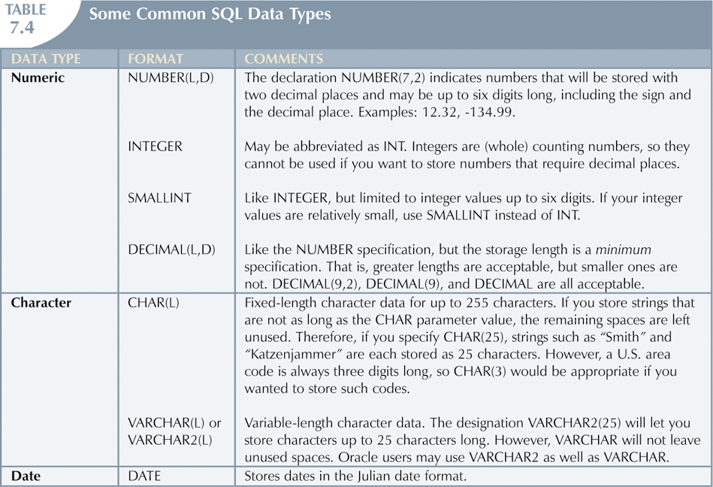

Slide 19
Alter Statement
Alter Statement:
used to make changes to the schema of the table. Columns can be added and the data type of the columns changed as long as the data in those columns conforms to the data type specified.
ALTER TABLE - ADD Column
Syntax:
ALTER TABLE table_name ADD column_name datatype;
Example:
ALTER TABLE stud ADD (Age number(2),
ADD Mark1 number(3),
ADD Mark2 number(3));
The stud table is already exist and then we added three more columns Age ,Mark1 and Mark2 respectively, by the use of above command.

Slide 20
Alter Statement(contd..)
2. ALTER TABLE - DROP COLUMN
Syntax:
ALTER TABLE table_name DROP COLUMN column_name;
Example:
ALTER TABLE stud
DROP COLUMN Mark2;
This command will drop particular column mark2.
3. ALTER TABLE - ALTER/MODIFY COLUMN
Syntax:
ALTER TABLE table_name MODIFY COLUMN column_name datatype;
Example:
ALTER TABLE stud
MODIFY (Name varchar2(60));
The Name column already exist in stud table, it was char and size 50, now it is modified by varchar2 and size 60.

Slide 21
Drop Table Statement
DROP TABLE
-Drop an existing table in a database.
Syntax:
DROP TABLE table_name;
Example:
DROP TABLE stud;
This will destroy the table and all data which will be recorded in it.

Slide 22
Truncate Table Statement
TRUNCATE TABLE
-Truncates the contents in an existing table in a database.
Syntax:
TRUNCATE TABLE table_name;
Example:
TRUNCATE TABLE stud;
This will delete the contents in the table. But structure remains the same

Slide 23
Rename Table Statement
RENAME TABLE
-Truncates the contents in an existing table in a database.
Syntax:
RENAME OldTableName
TO NewTableName;
Example:
RENAME stud
TO student;
The old name table was stud now new name is the student.

Slide 24
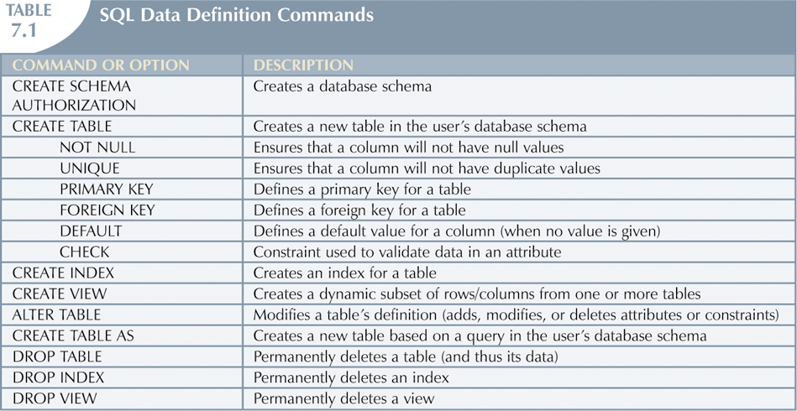

Slide 25
DML-Data Manipulation Language

Slide 26
Select Statement
To display only selected fields
Syntax:
SELECT column1, column2, ... FROM table_name;
Here, column1, column2, ... are the field names of the table you want to select data from
Example
SELECT name, age FROM stud;
To display all the fields available in the table
Syntax:
SELECT * FROM table_name;
Example
SELECT * FROM stud;

Slide 27
Insert Statement
The INSERT INTO statement is used to insert new records in a table.
Syntax:
INSERT INTO table_name VALUES (value1, value2, value3, ...);
Example
INSERT INTO stud VALUES (100, ‘Asha’, ‘27-Jan-2021’, ‘First Street’, 15, 89, 90);
1 row will be created
Insert NULL Value to a column
INSERT INTO stud VALUES (101, ‘Alex’, ‘27-feb-2021’, ‘Second Street’, null, 98, 79);
The above command will insert null to age column.
Insert Default value to a column
INSERT into Student values(103,'Chris')
Suppose the age column of student table has default value of 14.
Also, if you run the below query, it will insert default value into the age column, whatever the default value may be.

Slide 28
Where Clause
Where clause is used to specify condition while retrieving data from table. Where clause is used mostly with Select, Update and Delete query. If condition specified by where clause is true then only the result from table is returned.
Syntax:
SELECT column1, column2, ... FROM table_name WHERE condition;
Example
SELECT regno, name
FROM stud WHERE regno=101;
This displays only the regno and name of the stud with regno 101.
SELECT *FROM stud WHERE regno=101;
This displays the all the details of the stud with regno 101.

Slide 29
Update Statement
The UPDATE statement is used to modify the existing records in a table..
Syntax:
UPDATE table_name SET column1 = value1, column2 = value2, ... WHERE condition;;
Example
UPDATE stud SET name = 'Alfred ', age= 15 WHERE regno = 103;
The above command will update two columns of a record.

Slide 30
Delete Statement
The DELETE statement is used to delete all records in a table.
Syntax:
DELETE FROM table_name;
Example
DELETE FROM stud;
Delete command can also be used with condition to delete a particular row
Syntax:
DELETE FROM table_name
WHERE condition;
Example
DELETE FROM stud
WHERE regno=105;

Slide 31
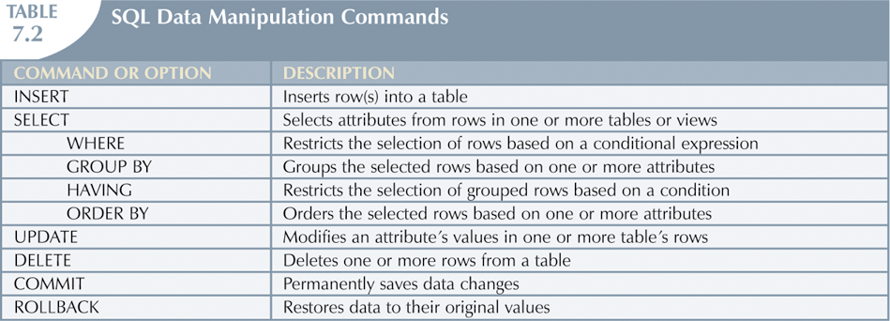

Slide 32
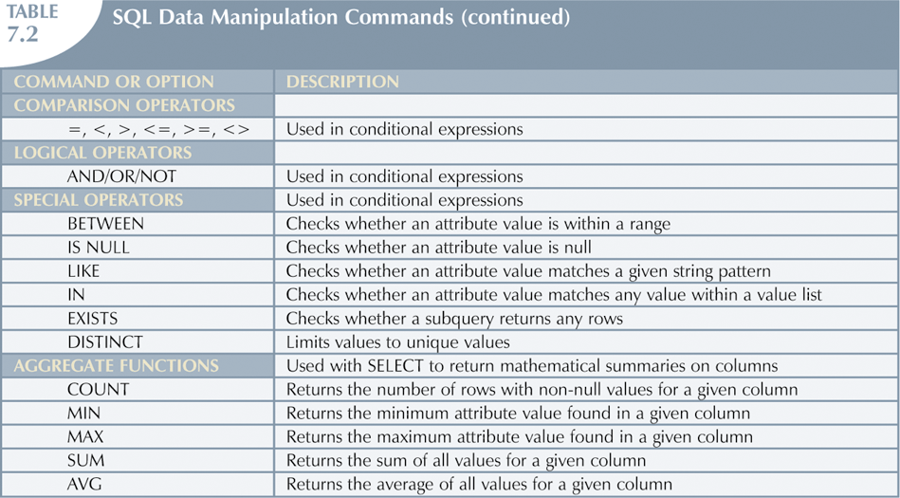

Slide 33
Constraints
Defining Constraints-Primary Key, Foreign Key, Unique, not null, check, IN operator

Slide 34
Constraints
Integrity constraints ensure that changes made to the database do not result in a loss of data consistency.
Examples:
• An instructor name cannot be null.
• No two instructors can have the same instructor ID.
• Every department name in the course relation must have a matching department name in the department relation.
• The budget of a department must be greater than $0.00.
integrity constraints that can be tested with minimal overhead (cost).

Slide 35
Constraints
(1) Integrity constraints are declared as part of the create table command
(2) Integrity constraints can also be added to an existing relation by using
alter table table-name add constraint
Constraints on a Single Relation
• primary key
• not null
• unique
• check(<predicate>)

Slide 36
Constraints
The general form of the create table command is:
create table r
(A1 D1,
A2 D2,
. . . ,
An Dn,
integrity-constraint1,
. . . ,
integrity-constraintk);
where r is the name of the relation, each Ai is the name of an attribute in the schema of relation r, and Di is the domain of attribute Ai; that is, Di specifies the type of attribute Ai along with optional constraints that restrict the set of allowed values for Ai .

Slide 37
Constraints
Primary key
primary key (Aj1 , Aj2, . . . , Ajm ): The attributes Aj1 , Aj2, . . . , Ajm form the primary key for the relation. The primary key attributes are required to be not null and unique;
• foreign key (Ak1 , Ak2, . . . , Akn ) references s: The values of attributes (Ak1 , Ak2, . . . , Akn ) for any tuple in the relation must correspond to values of the primary key attributes of some tuple in relation s.

Slide 38
Constraints
Example:
create table department
(dept name varchar (20),
building varchar (15),
budget numeric (12,2),
primary key (dept name));
create table course
(course id varchar (7),
title varchar (50),
dept name varchar (20),
credits numeric (2,0),
primary key (course id),
foreign key (dept name) references department);

Slide 39
Constraints
Not Null Constraint
For certain attributes, null values may be inappropriate.
prohibits the insertion of a null value for the attribute. That is the null value is not allowed for that attribute.
Example:
create table instructor
(ID varchar (5),
name varchar (20) not null,
dept name varchar (20),
salary numeric (8,2),
primary key (ID),
foreign key (dept name) references department);

Slide 40
Constraints
Unique Constraint
unique (Aj1 , Aj2, . . . , Ajm )
attributes Aj1 , Aj2, . . . , Ajm form a candidate
key; that is, no two tuples in the relation can be equal on all the listed attributes.

Slide 41
Constraints
The check Clause
The clause check(P) specifies a predicate P that must be satisfied by every tuple in a relation.
ensure that attribute values satisfy specified conditions
Example:
create table section
(course id varchar (8),
sec id varchar (8),
semester varchar (6),
year numeric (4,0),
building varchar (15),
room number varchar (7),
time slot id varchar (4),
primary key (course id, sec id, semester, year),
check (semester in (’Fall’, ’Winter’, ’Spring’, ’Summer’)));

Slide 42
Constraints
Referential Integrity
ensure that a value in one relation for a given set of attributes also appears for a certain set of attributes in another relation.
Foreign keys can be specified as part of the SQL create table statement by using the foreign key clause
Example: “foreign key (dept name) references department”
Let r1 and r2 be relations whose set of attributes are R1 and R2, respectively, with primary keys K1 and K2. The subset of R2 is a foreign key referencing K1 in relation r1 if it is required that, for every tuple t2 in r2, there must be a tuple t1 in r1 such that t1.K1 = t2..

Slide 43
Constraints
Referential Integrity
create table department
(dept name varchar (20),
building varchar (15),
budget numeric (12,2) check (budget > 0),
primary key (dept name))
create table course
(course id varchar (8),
title varchar (50),
dept name varchar (20),
credits numeric (2,0) check (credits > 0),
primary key (course id),
foreign key (dept name) references department)

Slide 44
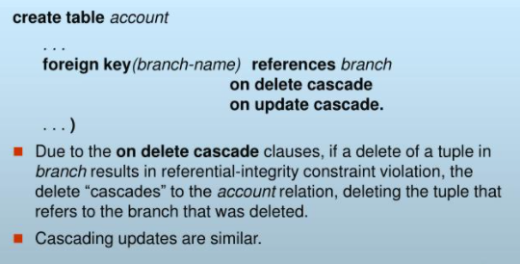
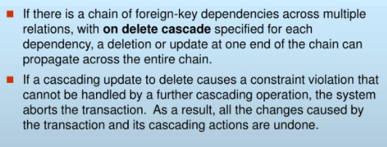
Constraints

Slide 45
SQL
Built-in Functions

Slide 46
What are Built-In Functions?
In SQL a built-in function is a piece for programming that takes zero or more inputs and returns a value.
An example of a built-in function is ABS(), which when given a value calculates the absolute (non-negative) value of the number.
ABS () are used to perform calculations.
GETDATE () are used to obtain a system value, such as the current data.
LEFT (), are used to manipulate textual data.
SELECT Name,
ABS(500 - ReorderPoint) ReorderPointDeviation
FROM production.Product
WHERE ABS(500 - ReorderPoint) > 200

Slide 47
Function Categories
Numeric Functions – perform advanced calculations and round numbers.
String Functions – change text values to all upper case, or remove the trailing spaces from values.
Conversion Functions – Convert data with CAST and CONVERT
Group Functions- functions that operate on groups of rows and return one value for the entire group
Date Functions – add days or months to a date. Calculate the day of the week from the date.

Slide 48
Numeric Functions
Function | Input Argument | Value Returned
ABS ( m ) | m = value | Absolute value of m
MOD ( m, n ) | m = value, n = divisor | Remainder of m divided by n
POWER ( m, n ) | m = value, n = exponent | m raised to the nth power
ROUND ( m [, n ] ) | m = value, n = number of decimal places, default 0 | m rounded to the nth decimal place
TRUNC ( m [, n ] ) | m = value, n = number of decimal places, default 0 | m truncated to the nth decimal place
SIN ( n ) | n = angle expressed in radians | sine (n)
COS ( n ) | n = angle expressed in radians | cosine (n)
TAN ( n ) | n = angle expressed in radians | tan (n)
ASIN ( n ) | n is in the range -1 to +1 | arc sine of n in the range -π/2 to +π/2
ACOS ( n ) | n is in the range -1 to +1 | arc cosine of n in the range 0 to π
ATAN ( n ) | n is unbounded | arc tangent of n in the range -π/2 to + π/2
SINH ( n ) | n = value | hyperbolic sine of n
COSH ( n ) | n = value | hyperbolic cosine of n
TANH ( n ) | n = value | hyperbolic tangent of n
SQRT ( n ) | n = value | positive square root of n
EXP ( n ) | n = value | e raised to the power n
LN ( n ) | n > 0 | natural logarithm of n
LOG ( n2, n1 ) | base n2 any positive value other than 0 or 1, n1 any positive value | logarithm of n1, base n2
CEIL ( n ) | n = value | smallest integer greater than or equal to n
FLOOR ( n ) | n = value | greatest integer smaller than or equal to n
SIGN ( n ) | n = value | -1 if n < 0, 0 if n = 0, and 1 if n > 0

Slide 49
Here are some examples of the use of some of these numeric functions:
 | select select select | round (83.28749, sqrt (3.67) from power (2.512, 5) | 2) from dual; dual; from dual;
String Functions
Function | Input Argument | Value Returned
INITCAP ( s ) | s = character string | First letter of each word is changed to uppercase and all other letters are in lower case.
LOWER ( s ) | s = character string | All letters are changed to lowercase.
UPPER ( s ) | s = character string | All letters are changed to uppercase.
CONCAT ( s1, s2 ) | s1 and s2 are character strings | Concatenation of s1 and s2. Equivalent to s1 || s2
LPAD ( s1, n [, s2] ) | s1 and s2 are character strings and n is an integer value | Returns s1 right justified and padded left with n characters from s2; s2 defaults to space.
RPAD ( s1, n [, s2] ) | s1 and s2 are character strings and n is an integer value | Returns s1 left justified and padded right with n characters from s2; s2 defaults to space.
LTRIM ( s [, set ] ) | s is a character string and set is a set of characters | Returns s with characters removed up to the first character not in set; defaults to space
RTRIM ( s [, set ] ) | s is a character string and set is a set of characters | Returns s with final characters removed after the last character not in set; defaults to space

Slide 50
String Functions
REPLACE ( s, search_s [, replace_s ] ) | s = character string, search_s = target string, replace_s = replacement string | Returns s with every occurrence of search_s in s replaced by replace_s; default removes search_s
SUBSTR ( s, m [, n ] ) | s = character string, m = beginning position, n = number of characters | Returns a substring from s, beginning in position m and n characters long; default returns to end of s.
LENGTH ( s ) | s = character string | Returns the number of characters in s.
INSTR ( s1, s2 [, m [, n ] ] ) | s1 and s2 are character strings, m = beginning position, n = occurrence of s2 in s1 | Returns the position of the nth occurrence of s2 in s1, beginning at position m, both m and n default to 1.
Here are some examples of the use of String functions:
select concat ('Alan', 'Turing') as "NAME" from dual; select 'Alan' || 'Turing' as "NAME" from dual;
select initcap ("now is the time for all good men to come to the aid of the party") as "SLOGAN" from dual;
select substr ('Alan Turing', 1, 4) as "FIRST" from dual;

Slide 51
String / Number Conversion Functions
Function | Input Argument | Value Returned
NANVL ( n2, n1 ) | n1, n2 = value | if (n2 = NaN) returns n1 else returns n2
TO_CHAR ( m [, fmt ] ) | m = numeric value, fmt = format | Number m converted to character string as specified by the format
TO_NUMBER ( s [, fmt ] ) | s = character string, fmt = format | Character string s converted to a number as specified by the format
Formats for TO_CHAR Function
Symbol | Explanation
9 | Each 9 represents one digit in the result
0 | Represents a leading zero to be displayed
$ | Floating dollar sign printed to the left of number
L | Any local floating currency symbol
. | Prints the decimal point
, | Prints the comma to represent thousands

Slide 52
Group Functions
Function | Input Argument | Value Returned
AVG ( [ DISTINCT | ALL ] col ) | col = column name | The average value of that column
COUNT ( * ) | none | Number of rows returned including duplicates and NULLs
COUNT ( [ DISTINCT | ALL ] col ) | col = column name | Number of rows where the value of the column is not NULL
MAX ( [ DISTINCT | ALL ] col ) | col = column name | Maximum value in the column
MIN ( [ DISTINCT | ALL ] col ) | col = column name | Minimum value in the column
SUM ( [ DISTINCT | ALL ] col ) | col = column name | Sum of the values in the column
CORR ( e1, e2 ) | e1 and e2 are column names | Correlation coefficient between the two columns after eliminating nulls
MEDIAN ( col ) | col = column name | Middle value in the sorted column, interpolating if necessary
STDDEV ( [ DISTINCT | ALL ] col ) | col = column name | Standard deviation of the column ignoring NULL values
VARIANCE ( [ DISTINCT | ALL ] col ) | col = column name | Variance of the column ignoring NULL values

Slide 53
SQL AVG():
This function is used to get the average value of a numeric column.
To get the average salary, the query would be
SELECT AVG (salary) FROM employee;
SQL COUNT ():
This function returns the number of rows in the table that satisfies the condition specified in the WHERE condition. If the WHERE condition is not specified, then the query returns the total number of rows in the table.
For Example: If you want the number of employees in a particular department, the query would be:

Slide 54
SELECT COUNT (*) FROM employee WHERE dept = 'Electronics';
The output would be '2' rows.
If you want the total number of employees in all the department, the query would take the form:
SELECT COUNT (*) FROM employee;
The output would be '5' rows
SQL DISTINCT ():
This function is used to select the distinct rows.

Slide 55
For Example:
If you want to select all distinct department names from employee table, the query would be:
SELECT DISTINCT dept FROM employee;
To get the count of employees with unique name, the query would be:
SELECT COUNT (DISTINCT name) FROM employee;
SQL MAX ():
This function is used to get the maximum value from a column.
To get the maximum salary drawn by an employee, the query would be:
SELECT MAX (salary) FROM employee;

Slide 56
SQL MIN ():
This function is used to get the minimum value from a column.
To get the minimum salary drawn by an employee, he query would be:
SELECT MIN (salary) FROM employee;
SQL SUM ():
This function is used to get the sum of a numeric column
To get the total salary given out to the employees,
SELECT SUM (salary) FROM employee;

Slide 57
Date and Time Functions
Function | Input Argument | Value Returned
ADD_MONTHS ( d, n ) | d = date, n = number of months | Date d plus n months
LAST_DAY ( d ) | d = date | Date of the last day of the month containing d
MONTHS_BETWEEN ( d, e ) | d and e are dates | Number of months by which e precedes d
NEW_TIME ( d, a, b ) | d = date, a = time zone (char), b = time zone (char) | The date and time in time zone b when date d is for time zone a
NEXT_DAY ( d, day ) | d = date, day = day of the week | Date of the first day of the week after d
SYSDATE | none | Current date and time
GREATEST ( d1, d2, ..., dn ) | d1 ... dn = list of dates | Latest of the given dates
LEAST ( d1, d2, ..., dn ) | d1 ... dn = list of dates | Earliest of the given dates
Date Conversion Functions
Function | Input Argument | Value Returned
TO_CHAR ( d [, fmt ] ) | d = date value, fmt = format for string | The date d converted to a string in the given format
TO_DATE ( s [, fmt ] ) | s = character string, fmt = format for date | String s converted to a date value
ROUND ( d [, fmt ] ) | d = date value, fmt = format for string | Date d rounded as specified by the format
TRUNC ( d [, fmt ] ) | d = date value, fmt = format for string | Date d truncated as specified by the format

Slide 58
Date Formats
Format Code | Description | Range of Values
DD | Day of the month | 1 - 31
DY | Name of the day in 3 uppercase letters | SUN, ..., SAT
DAY | Complete name of the day in uppercase, padded to 9 characters | SUNDAY, ..., SATURDAY
MM | Number of the month | 1 - 12
MON | Name of the month in 3 uppercase letters | JAN, ..., DEC
MONTH | Name of the month in uppercase padded to a length of 9 characters | JANUARY, ..., DECEMBER
RM | Roman numeral for the month | I, ..., XII
YY or YYYY | Two or four digit year | 71 or 1971
HH:MI:SS | Hours : Minutes : Seconds | 10:28:53
HH 12 or HH 24 | Hour displayed in 12 or 24 hour format | 1 - 12 or 1 - 24
MI | Minutes of the hour | 0 - 59
SS | Seconds of the minute | 0 - 59
AM or PM | Meridian indicator | AM or PM
SP | A suffix that forces the number to be spelled out. | e.g. TWO THOUSAND NINE
TH | A suffix meaning that the ordinal number is to be added | e.g. 1st, 2nd, 3rd, ...
FM | Prefix to DAY or MONTH or YEAR to suppress padding | e.g. MONDAY with no extra spaces at the end

Slide 59
Here are some examples of the use of the Date functions:
select to_char ( sysdate, 'MON DD, YYYY' ) from dual; select to_char ( sysdate, 'HH12:MI:SS AM' ) from dual;
select to_char( new_time(sysdate,'CDT','GMT'),'HH24:MI')from dual; select greatest (to_date ( 'JAN 19, 2000', 'MON DD, YYYY' ),
to_date ( 'SEP 27, 1999', 'MON DD, YYYY' ), to_date ( '13-Mar-2009', 'DD-Mon-YYYY' ) )
from dual;
select next_day ( sysdate, 'FRIDAY' ) from dual;

Slide 60
Subqueries

Slide 61
Subqueries
A query can be processed inside another query.
A subquery is select statement that is embedded in the clause of another select statement
Inner query and outer query : inner query returns a value that is used by outer query.

Slide 62
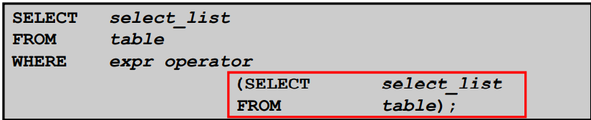
Syntax for subquery

Slide 63
Ex..
Who is earning more salary than Mr.John?
Need to find the John salary first (inner query) then compare the value with others salary (outer query)
select salary from emp where salary >
(select salary from emp where ename=“Mr.John”);

Slide 64
SUB-QUERIES OR NESTED QUERIES
Display the employee name who is getting the minimum salary.
SQL> select empname from employees where salary =(select min(salary) from employees);
EMPNAME
--------------------
Mark
Nadia
Nadal
Diwaagar
Charles

Slide 65
SUB-QUERIES OR NESTED QUERIES
Who is the youngest male employee
SQL> select empname,dob from employees where dob=(select max(dob) from employees where sex='Male');
EMPNAME DOB
-------------------- ---------
charles 29-DEC-98

Slide 66
Using Having clause..
Select departmentid,min(salary) from emp
group by departmentid
Having min(salary) >
(select min(salary) from emp where departmentid=50);
This query returns all departments minimum salary that has greater than the minimum salary of department id is 50

Slide 67
Set Operations
The set operations union, intersect, and except operate on relations and correspond to the relational algebra operations ∪, ∩, −.
Each of the above operations automatically eliminates duplicates; to retain all duplicates use the corresponding multiset versions union all, intersect all and except all.

Slide 68
Set Operations
Find all customers who have a loan, an account, or both:
(select customer-name from depositor) union (select customer-name from borrower)
Find all customers who have both a loan and an account.
(select customer-name from depositor) intersect (select customer-name from borrower)
Find all customers who have an account but no loan.
(select customer-name from depositor) except (select customer-name from borrower)

Slide 69
Views
It is not necessary for all users to see the entire logical model (that is, all the actual relations stored in the database.)
Consider a person who needs to know an instructors name and department, but not the salary. This person should see a relation described, in SQL, by select ID, name, dept_name from instructor
A view provides a mechanism to hide certain data from the view of certain users.
Any relation that is not of the conceptual model but is made visible to a user as a “virtual relation” is called a view.

Slide 70
View Creation
A view is defined using the create view statement which has the form
create view v as < query expression >
where <query expression> is any legal SQL expression. The view name is represented by v.
Once a view is defined, the view name can be used to refer to the virtual relation that the view generates.
View definition is not the same as creating a new relation by evaluating the query expression
Rather, a view definition causes the saving of an expression; the expression is substituted into queries using the view.

Slide 71
Display view details
A view of instructors without their salary
create view faculty as select ID, name, dept_name from instructor
Find all instructors in the Biology department
select name from faculty where dept_name = 'Biology'
Create a view of department salary totals
create view departments_total_salary(dept_name, total_salary) as select dept_name, sum (salary) from instructor group by dept_name;

Slide 72
One view may be used in the expression defining another view
A view relation v₁ is said to depend directly on a view relation v₂ if v₂ is used in the expression defining v₁
A view relation v₁ is said to depend on view relation v₂ if either v₁ depends directly to v₂ or there is a path of dependencies from v₁ to v₂
A view relation v is said to be recursive if it depends on itself.

Slide 73
Materialized Views
Certain database systems allow view relations to be physically stored.
Physical copy created when the view is defined.
Such views are called Materialized view:
If relations used in the query are updated, the materialized view result becomes out of date
Need to maintain the view, by updating the view whenever the underlying relations are updated.

Slide 74
View Update
Add a new tuple to faculty view which we defined earlier
insert into faculty
values ('30765', 'Green', 'Music');
This insertion must be represented by the insertion into the instructor relation
Must have a value for salary.
Two approaches
Reject the insert
Inset the tuple
('30765', 'Green', 'Music', null)
into the instructor relation

Slide 75
Update Views Rules
Most SQL implementations allow updates only on simple views
The from clause has only one database relation.
The select clause contains only attribute names of the relation, and does not have any expressions, aggregates, or distinct specification.
Any attribute not listed in the select clause can be set to null
The query does not have a group by or having clause.

Slide 76
Transaction
A transaction consists of a sequence of query and/or update statements and is a “unit” of work
The SQL standard specifies that a transaction begins implicitly when an SQL statement is executed.
The transaction must end with one of the following statements:
Commit work. The updates performed by the transaction become permanent in the database.
Rollback work. All the updates performed by the SQL statements in the transaction are undone.
Atomic transaction
either fully executed or rolled back as if it never occurred
Isolation from concurrent transactions

Slide 77
Triggers
A trigger is a stored procedure in database which automatically invokes whenever a special event in the database occurs. For example, a trigger can be invoked when a row is inserted into a specified table or when certain table columns are being updated.
Triggers are composed to be executed in light of any of the accompanying occasions.
A database control (DML) statement (DELETE, INSERT, or UPDATE).
A database definition (DDL) statement (CREATE, ALTER, or DROP).
A database operation (SERVERERROR, LOGON, LOGOFF, STARTUP, or SHUTDOWN).

Slide 78
The syntax of Triggers in SQL–
CREATE [OR REPLACE ] TRIGGER trigger_name
{BEFORE | AFTER | INSTEAD OF }
{INSERT [OR] | UPDATE [OR] | DELETE}
[OF col_name]
ON table_name
[REFERENCING OLD AS o NEW AS n]
[FOR EACH ROW]
WHEN (condition)
DECLARE
Declaration-statements
BEGIN
Executable-statements
EXCEPTION
Exception-handling-statements
END;
Create [OR REPLACE] TRIGGER trigger_name: It makes or replaces a current trigger with the trigger_name.

Slide 79
EXAMPLE
CREATE OR REPLACE TRIGGER display_salary_changes
BEFORE DELETE OR INSERT OR UPDATE ON customers
FOR EACH ROW
WHEN (NEW.ID > 0)
DECLARE
sal_diff number;
BEGIN
sal_diff := :NEW.salary - :OLD.salary;
dbms_output.put_line('Old salary: ' || :OLD.salary);
dbms_output.put_line('New salary: ' || :NEW.salary);
dbms_output.put_line('Salary difference: ' || sal_diff);
END;

Slide 80
After creating a Trigger, use it in the PL/SQL code for putting it in to action.
DECLARE
total_rows number(2);
BEGIN
UPDATE customers
SET salary = salary + 5000;
IF sql%notfound THEN
dbms_output.put_line('no customers updated');
ELSIF sql%found THEN
total_rows := sql%rowcount;
dbms_output.put_line( total_rows || ' customers updated ');
END IF;
END;
/

Slide 81
Advantages of Triggers
Triggers can be written for the following purposes −
Generating some derived column values automatically
Enforcing referential integrity
Event logging and storing information on table access
Auditing
Synchronous replication of tables
Imposing security authorizations
Preventing invalid transactions

Slide 82
Basic Steps in Query Processing Query Processing is the activity performed in extracting data from the database. In query processing, it takes various steps for fetching the data from the database.
1. Parsing and translation
2. Optimization
3. Evaluation

Slide 83
Basic Steps in Query Processing (Cont.)
Parsing and translation
translate the query into its internal form. This is then translated into relational algebra.
Parser checks syntax, verifies relations
Evaluation
The query-execution engine takes a query-evaluation plan, executes that plan, and returns the answers to the query.

Slide 84
Basic Steps in Query Processing : Optimization
A relational algebra expression may have many equivalent expressions
E.g., σ_{salary<75000}(∏_{salary}(instructor)) is equivalent to ∏_{salary}(σ_{salary<75000}(instructor))
Each relational algebra operation can be evaluated using one of several different algorithms
Correspondingly, a relational-algebra expression can be evaluated in many ways.
Annotated expression specifying detailed evaluation strategy is called an evaluation-plan.
E.g., can use an index on salary to find instructors with salary < 75000,
or can perform complete relation scan and discard instructors with salary ≥ 75000

Slide 85
Basic Steps: Optimization (Cont.)
Query Optimization: Amongst all equivalent evaluation plans choose the one with lowest cost.
Cost is estimated using statistical information from the database catalog
e.g. number of tuples in each relation, size of tuples, etc.

Slide 86
Introduction to PL/SQL
Procedural Language extension for SQL
Oracle Proprietary
3GL Capabilities
Integration of SQL
Portable within Oracle data bases
Callable from any client

Slide 87
Structure of PL/SQL
PL/SQL is Block Structured
A block is the basic unit from which all PL/SQL programs are built. A block can be named (functions and procedures) or anonymous
Sections of block
1- Header Section
2- Declaration Section
3- Executable Section
4- Exception Section

Slide 88
Structure of PL/SQL
HEADER
Type and Name of block
DECLARE
Variables; Constants; Cursors;
BEGIN
PL/SQL and SQL Statements
EXCEPTION
Exception handlers
END;

Slide 89
Structure of PL/SQL
DECLARE
a number;
text1 varchar2(20);
text2 varchar2(20) := “HI”;
BEGIN
---------- ---------- ----------
END;
Important Data Types in PL/SQL include NUMBER, INTEGER, CHAR, VARCHAR2, DATE etc
to_date(‘02-05-2007','dd-mm-yyyy') { Converts String to Date}

Slide 90
Structure of PL/SQL
Data Types for specific columns
Variable_name Table_name.Column_name%type;
This syntax defines a variable of the type of the referenced column on the referenced table

Slide 91
PL/SQL Control Structure
PL/SQL has a number of control structures which includes:
Conditional controls
Iterative or loop controls.
Exception or error controls
It is these controls, used singly or together, that allow the PL/SQL developer to direct the flow of execution through the program.

Slide 92
PL/SQL Control Structure
Conditional Controls
IF....THEN....END IF;
IF....THEN...ELSE....END IF;
IF....THEN...ELSIF....THEN....ELSE....END IF;

Slide 93
PL/SQL Control Structure
LOOP
...SQL Statements...
EXIT;
END LOOP;
WHILE loops
WHILE condition LOOP
...SQL Statements...
END LOOP;
FOR loops
FOR <variable(numeric)> IN [REVERSE] <lowerbound>..<upperbound> LOOP .... ..... END LOOP;

Slide 94
PL/SQL Control Structure
Cursor
DECLARE name varchar2(20);
Cursor c1 is
select t.name
from table t
where date is not null;
BEGIN
OPEN c1;
LOOP
FETCH c1 into name;
exit when c1%NOTFOUND;
END LOOP;
CLOSE c1;
END;

Slide 95
Debuging
show error
DBMS_OUTPUT.PUT_LINE(‘ .. ‘);

Slide 96
Execution
How to execute a function in PL/SQL?
Var issue_flag number;
exec :issue_flag:=fun_name(arg1,arg2,. . . .);
PRINT :issue_flag;
How to execute a procedure in PL/SQL?
Exec procedure_name(arg1,arg2,. . . .);

Slide 97
References
http://www.csee.umbc.edu/help/oracle8/server.815/a67842/01_oview.htm#740
http://en.wikipedia.org/wiki/PL/SQL
http://www.skillbuilders.com/Tutorials-V2/ora9i_Intro_to_PLSQL/ora9i_Intro_to_PLSQL.cfm
http://www.databasejournal.com/features/mysql/article.php/ 3569846/MySQL-Stored-Functions.htm
http://www.mysqltutorial.org/mysql-stored-function/
https://dev.mysql.com/doc/refman/5.7/en/create- procedure.html

Slide 98
THANK YOU

